Slide 1
Distinguishing Legal Information from Legal Advice Stacey Marz, smarz@courts.state.ak.us Family Law Self-Help Center, AK Court System

Slide 2
Definitions
Legal information
Facts about the law and the legal process
Legal advice
Advice about the course of action a client should take to further his or her own best interests

Slide 3
Unauthorized Practice of Law
Rule 63. Unauthorized Practice of Law - AS 08.08.230.
For purposes of AS 08.08.230 (making unauthorized practice of law a misdemeanor), "practice of law" is defined as:
(a) representing oneself by words or conduct to be an attorney, and, if the person is authorized to practice law in another jurisdiction but is not a member of the Alaska Bar Association, representing oneself to be a member of the Alaska Bar Association; and
(b) either (i) representing another before a court or governmental body which is operating in its adjudicative capacity, including the submission of pleadings, or (ii), for compensation, providing advice or preparing documents for another which affect legal rights or duties.

Slide 4
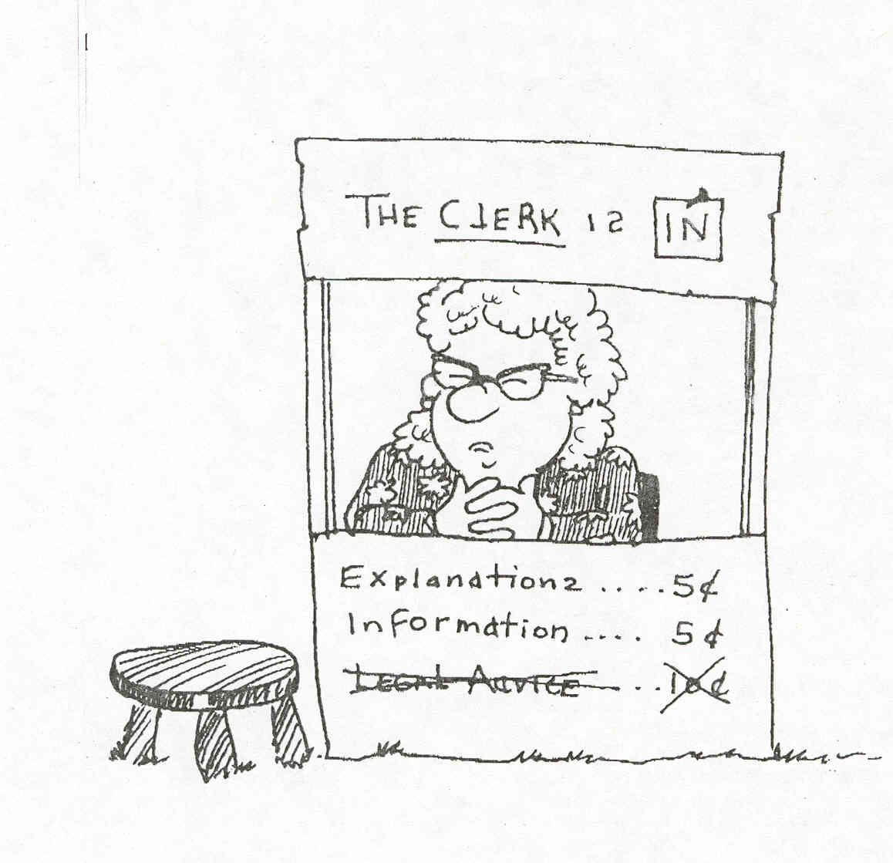
Is it Legal Advice?

Slide 5
Listen to the Question
TIP: Listen carefully to what people are asking you. The following phrases are clues as to whether someone is asking you for legal information or legal advice:
Probably asking for legal information: “What will happen at …?”
“Does the court have forms?
“How do I …?”
Probably asking for legal advice: “Should I …?”
“Could you tell me whether
I should …?”
“Which of these is best …?”

Slide 6
Legal Advice
The application of statutes and rules to individual claims or defenses
Whether the claim should best be brought in a federal or state court
Whether a complaint properly presents a claim
What the best procedures are to accomplish a particular objective
Interpretation of case law

Slide 7
General Guidelines
Legal information – generally about court process
Staff should answer questions that call for factual information – questions that start with “who,” “what,” “when,” “where,” or “how.”
Legal advice- advice about how a person should proceed, what action they should take or how they should describe their case to persuade the judge or jury to decide the case in their favor.
Staff should not answer questions directly that call for an opinion about what a litigant should do – questions that contain the words “should” or “whether.”
But turn these questions into legal learning opportunities.

Slide 8
General Guidelines
Legal information
Staff should tell a litigant how to bring an issue to the attention of the court.
Legal advice
Staff should not suggest whether it is wise to bring that issue before the court, how best to present the issue, or how the judge is likely to decide the case.

Slide 9
General Guidelines
Legal information
Staff should inform a litigant of his or her options and the steps to carry out an option
Legal advice
Staff should not suggest which option the litigant should pursue

Slide 10
Guidelines
Staff can explain common, routinely employed court rules and procedures
Staff cannot suggest which of several available procedures a litigant should follow
Staff should not attempt to apply a rule to the facts of a litigant’s case

Slide 11
Guidelines
Staff can tell litigants how to file a complaint or other pleading
Staff cannot advise litigants whether to file a complaint or other pleading, whom to name as a defendant in a complaint, what sort or amount of damages to seek, what arguments to include in a complaint or pleading, or what arguments to make in response to a filing by the other side

Slide 12
Guidelines
Staff can provide litigants with pamphlets or information on how to present evidence in court
Staff cannot tell litigants specific questions to ask witnesses in court
Staff cannot recommend techniques for presenting evidence in court
Staff cannot recommend objections to raise to motions or evidence submitted by the other side

Slide 13
Guidelines
Staff can explain the process for appealing a judge’s decision
Staff cannot recommend whether a litigant should appeal a judge’s decision

Slide 14
Guidelines
Staff can provide cites to (or show litigants how to find) statutes, court rules, and ordinances
Staff cannot provide an analysis or interpretation of statutes or ordinances based on the specific facts of a litigant’s case
Staff cannot perform legal research for a litigant

Slide 15
Guidelines
Staff can provide forms and instructions, and record on the forms information provided by the litigants if the litigants are not capable of filling out the form themselves
Staff cannot provide or suggest the specific information that should be entered on the forms

Slide 16
Understanding the Difference We Can Provide We Cannot Provide Legal Information: Legal Advice:
Legal definitions Legal Interpretations
Procedural explanation Procedural advice
Cites of statutes, court Research of statutes,
rules and ordinances court rules and ordinances
Public case information Confidential case info
General information on Confidential or restricted
court operations info on court operations

Slide 17
Understanding the Difference We Can Provide We Cannot Provide Legal Information: Legal Advice:
Options Opinions
Access Deny access, discourage access or encourage litigation
General referrals Subjective or biased referrals
Forms and instructions Fill out forms for a party on how to complete unless authorized by law or forms (May fill in if court rule authorized by law or court rule)

Slide 18
Turning legal advice questions into legal information
While you can’t give advice, you may be able to turn the question into a legal learning opportunity. Some examples:
Question: “Should I take my kids out of state to get away from my abusive ex?” Answer: “That question asks for legal advice which I can’t give you. However, I can tell you that when you file a case involving child custody, a standing order automatically goes into effect which says the parties cannot remove children from Alaska without an agreement or a court order. It is up to you to decide whether to file a custody case and how to comply with that order.”
For example, if given the question: “Should I subpoena the police officer to appear at my hearing?” You could answer: “I can’t give you legal advice. You need to talk to an attorney.” However, you can also say: “I can’t tell you whether you should or shouldn’t take a particular action in your case. However, I can explain how to get a subpoena and provide some general education about calling police officers as witnesses. In this jurisdiction, a police officer cannot appear in court without a subpoena because of the requirements of the police department. If you think the officer is important to presenting your case and you can’t otherwise get that information across, you can decide to subpoena the officer. Again, I’m not suggesting it is a good idea in your case. It is up to you to figure that out. If you decide to, I can discuss the forms for subpoenas.”

Slide 19
Also, you can use hypotheticals when speaking with customers, varying facts enough that the scenario doesn’t exactly match up with the customer’s situation but is still illustrative of the point to be made. For example, the customer says, “Should I file a motion to modify because my child’s father is now homeless, living in his car?” You could answer, “I can’t tell you whether you should or shouldn’t take action in your case. I can tell you that the statute to modify requires a change in circumstances. Examples of possible change in circumstances are a change in a parent’s living arrangements such as living in a homeless shelter with nowhere for the child to stay, moving out of state, going to jail, etc. If you think living in a car is a change that affects your child, you can ask the court to modify the custody arrangement. I can show you the options for forms that you can choose to file.”

Slide 20
Questions from Litigants How would you answer?
1. Should I hire an attorney? Do I need to have an attorney?
2. My ex refuses to let me have my daughter on Saturday nights even though that is what the court order says. What can I do?
3. My husband and I are separated. He is an illegal alien. I want to make sure he cannot get my daughter. What do I do?

Slide 21
Questions from Litigants
4. The father of my child is not on the birth certificate and has been away most of her life. He just showed up and wants to start supporting her and seeing her. I don’t want to let him see her and am afraid that he will take her away from me. What do I do?
5. Do you have a form to establish joint legal custody?

Slide 22
Thank You For Participating

