Slide 1
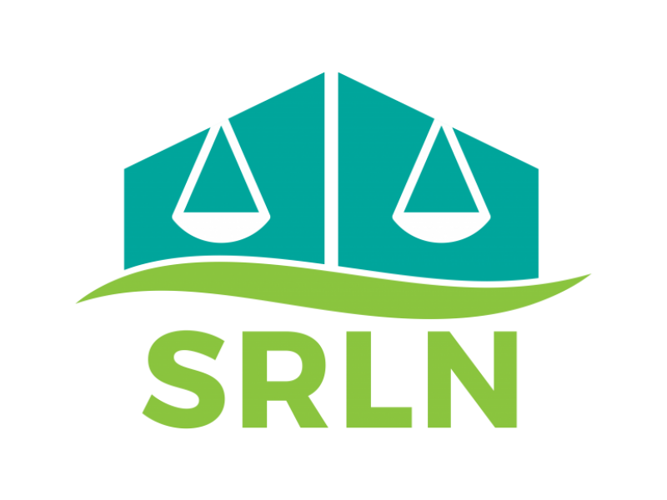
Securing User Feedback
Non-Lawyer Navigator Programs
Eduardo Gonzalez
Projects Manager, Self-Represented Litigation Network
Washington, D.C.
Twitter: A2JEG
eduardo@srln.org

Slide 2
Overview
User Feedback - high level
Activating Feedback Mechanisms
Q&A

Slide 3
Overview
User Feedback - high level
Activating Feedback Mechanisms
Q&A
Takeaway:
Taking the time to formulate what you want to know and why, and how you will/can use feedback information will provide you with a better understanding of the opportunities you need to find or create to accomplish your feedback goals.
You can start simple and build towards more complex analysis.

Slide 4
Feedback Framework
Feedback Mechanisms

Slide 5
Framework
“User”
Litigant/SRL/Public
Navigator - help agent
System professional - court
“Feedback”
Reaction or performance of a task used as a basis for improvement
Notes:
Feedback provides

Slide 6
Mechanisms
“User”
Litigant/SRL/Public
Navigator - help agent
System professional - court
“Feedback”
Reaction or performance of a task used as a basis for improvement
Spectrum of Feedback
Simple
Reactions
Observations
One-way response
Moderate
Surveys
Feedback boxes
Complex
Interviews
Focus Groups
Usability Testing
Notes:
Examples
Florida JFA
RePresent Games
Other resources to explore
https://ctb.ku.edu/en
https://www.usertesting.com/
https://www.userinterviews.com/
https://www.srln.org/taxonomy/term/737
Mathias Burton Problem Solving Call video - https://youtu.be/XlH3Flsh9x4

Slide 7
Activating Feedback Mechanisms

Slide 8
What does this mean?
For navigator: tools navigators are equipped with to serve the litigant
For litigant: the service and content they receive to assist in navigating process
For system professional: litigant’s expectation and behavior after assistance
Notes:
Does the device used to deliver the help in fact improve service?
Does the litigant succeed in the necessary tasks? Do they understand the process? Do they feel successful?
Does the system improve as intended?

Slide 9
What does this mean?
For navigator: tools navigators are equipped with to serve the litigant
For litigant: the service and content they receive to assist in navigating process
For system professional: litigant’s expectation and behavior after assistance
Common Tools
Existing information
Journey Mapping
Personas
Cultivating feedback channels
Team debrief
Notes:
Does the device used to deliver the help in fact improve service?
Does the litigant succeed in the necessary tasks? Do they understand the process? Do they feel successful?
Does the system improve as intended?

Slide 10
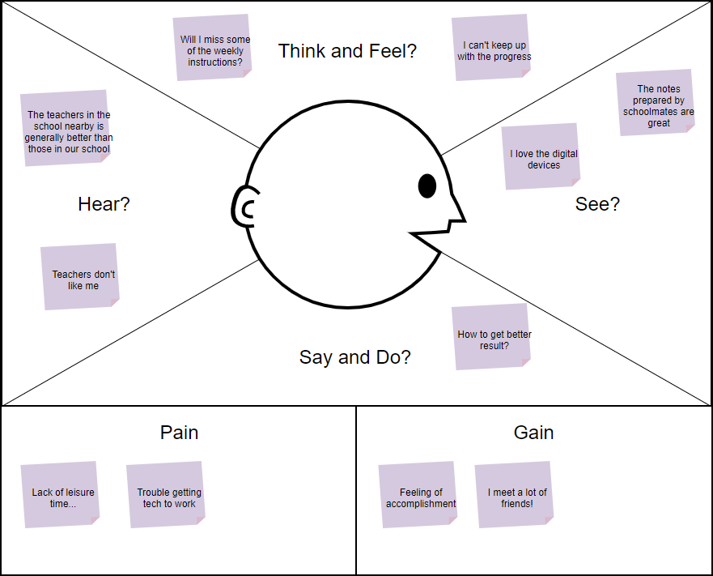

Slide 11
Useful resources
SRLN Resources:
Human Centered Design section: https://www.srln.org/taxonomy/term/737
SRLN Problem Solving Call - Mathias Burton’s presentation on remote usability testing & user feedback: https://youtu.be/XlH3Flsh9x4
Community Toolbox: https://ctb.ku.edu/en
User Testing: https://www.usertesting.com/
User Interviews: https://www.userinterviews.com/

Slide 12
Thank you!
Please feel free to reach out: eduardo@srln.org

